Slide 1
EDA
(Exploratory Data Analysis)
Haberman's Cancer Survival Dataset Report
--- By Gajjala Sagar Reddy

Slide 2
Introduction:
This dataset comes from the UCI Machine Learning Repository. It records survival data of breast cancer patients who underwent surgery between 1958 and 1970 at the University of Chicago’s Billings Hospital. Our goal is to analyse the patterns and identify the most important predictors of survival.

Slide 3
Objective:
The Main Objective to predict the breast cancer status by observing their Age ,Year ,Nodes and Status of the patient . The data is collected from a survey which was held between 1958-1969.
Conditions to be Applied:
High Level Statistics on the data set
Uni-variate Analysis
Bi-Variate Analysis

Slide 4
Dataset Overview :
The dataset contains 306 patient records.
Features that we have are Age ,Year ,Nodes ,Status.
Status — whether the patient survived at least 5 years post-surgery.
Among these, 225 patients survived, and 81 did not.
The dataset is therefore imbalanced.

Slide 5
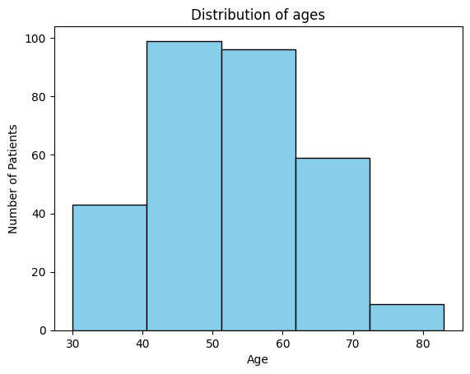
Univariate Analysis
From the univariate analysis:
Age ranges from 30 to 83, with most patients between 40 and 60.
Surgeries span 1958 to 1970.
Number of lymph nodes is highly skewed — most patients had 0 to 3 nodes.
About 73% survived, 27% did not.

Slide 6
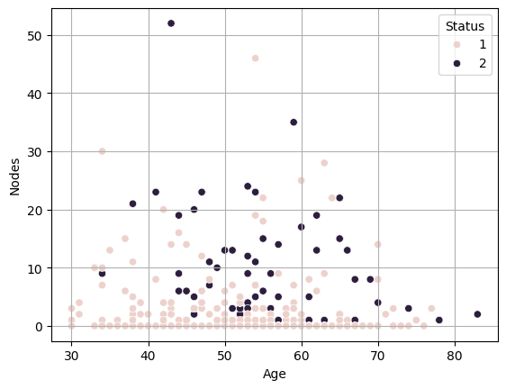
Bivariate Analysis
Age Will Not Create More Impact on the nodes and status of a patient
Here We Can Observe That at Age of 43-70 the survival chance is low

Slide 7
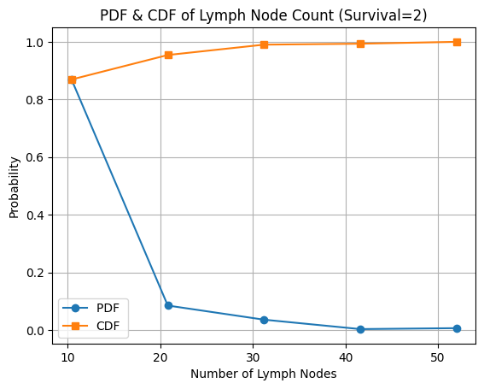
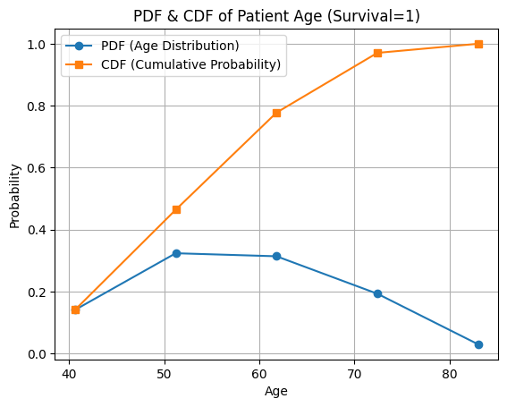
Pdf And Cdf
Age ranges from 30 to 83, with most patients between 40 and 60.
Year of operation spans 1958 to 1970.
Number of positive lymph nodes is right-skewed, with most patients having 0–3 nodes.

Slide 8
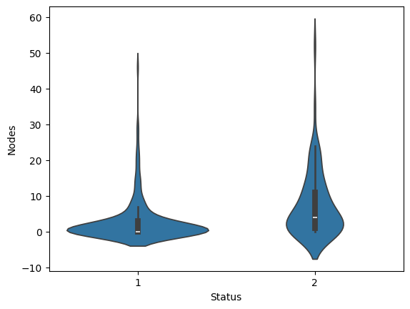
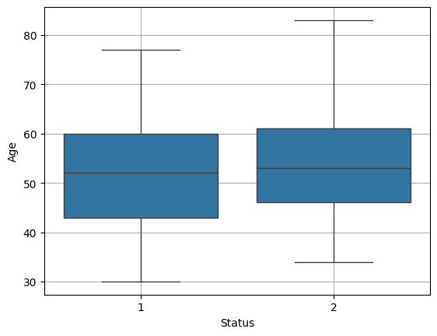
Box and Violin plot
At data-point 1 mostly the people having at 0-2 nodes where the survival rate is more
At data-point 2 the prople are lying with more nodes from 0-25 where the survival rate may differ
Mostly at the age of 43-62 are affected from the cancer and others are not affected more ,Then they are considered as the Ouliers

Slide 9
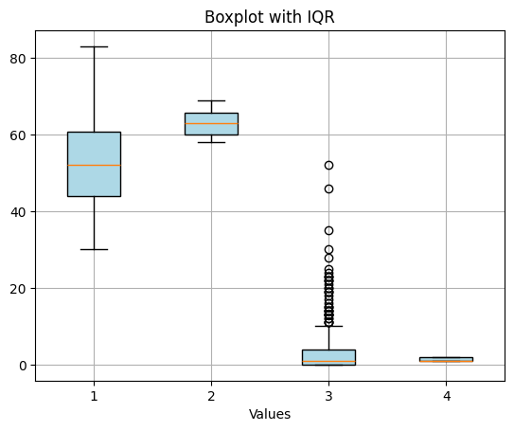
IQR(Inter Quantile Range):
Most patients had very few positive lymph nodes.
A few patients with a large number of nodes are statistical outliers.

Slide 10
Conclusions:
The dataset contains 306 patients with 3 numerical features (Age, Year, Nodes) and 1 categorical target (Status).
Survival after breast cancer surgery is heavily influenced by node count, making it the critical feature for predictive modelling.
The dataset is suitable for classification tasks, but preprocessing (handling outliers and class imbalance) is necessary.
Extreme node counts exist as outliers, mostly in non-survivors.
Age and year are weaker indicators, while class imbalance and outliers are important considerations.

